Slide 1
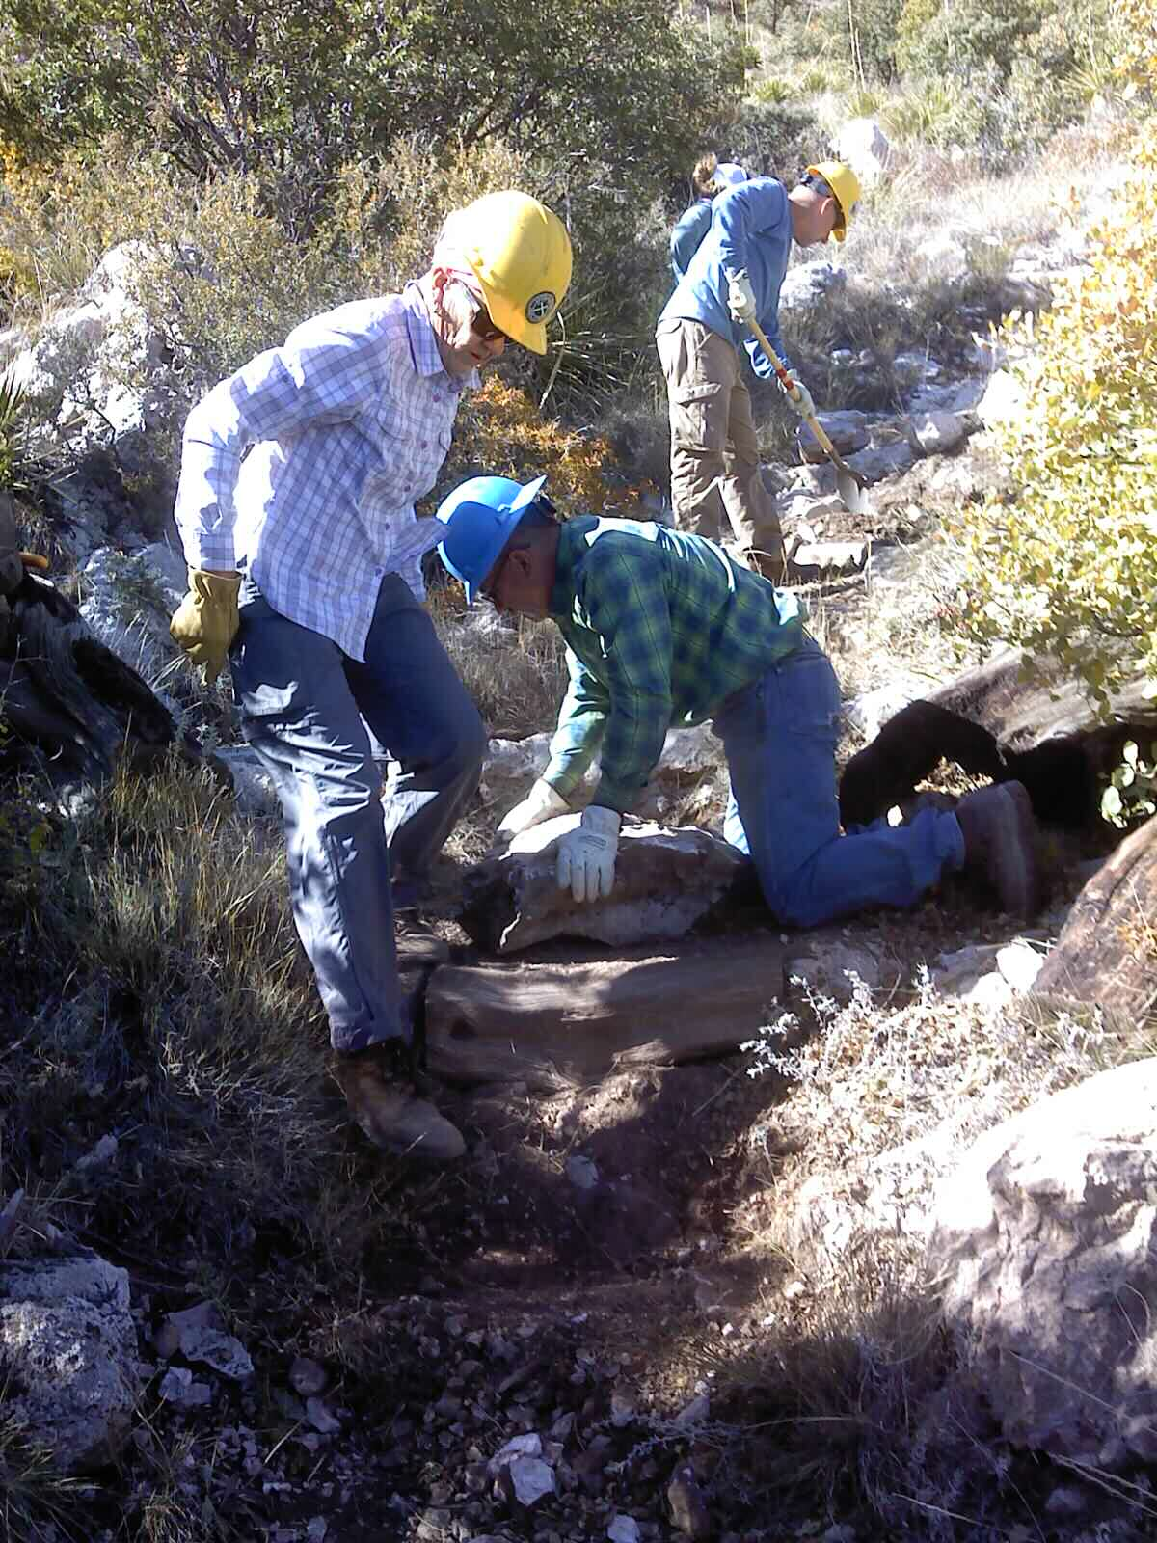
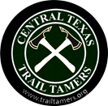
Central Texas Trail Tamers Introduction to Trails
August 30, 2023

Slide 2
Volunteers Building Trails Together Since 1993
The Central Texas Trail Tamers is a 501(c) non-profit organization dedicated to building and maintaining sustainable hiking trails.
Established in 1993, the Trail Tamers have provided thousands of hours of volunteer labor to public and non-profit agencies in eight states and two countries.

Slide 3
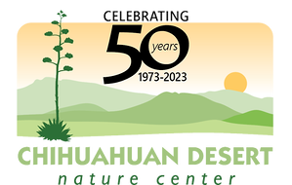
Central Texas Trail Tamers

Slide 4
What we will discuss today…
Trail Crew Member Responsibilities
Crew Member Safety
Understanding Trails and Hydrology
Trail Structures
Trail Design
Trail Maintenance

Slide 5
Trail Crew Member Responsibilities
Maintaining and improving the trail tread.
Maintaining and constructing structures such as rock walls, steps, or bridges.
Clearing overgrown vegetation on the trail and removing fallen trees.
Revegetate old trails to prevent erosion.
Communicate safety or work concerns to crew leader.
Operate tools and equipment; including hand tools, small power tools, and chainsaws.
Perform routine equipment maintenance, such as sharpening or repairing hand tools.
Work in the backcountry without access to amenities.

Slide 6
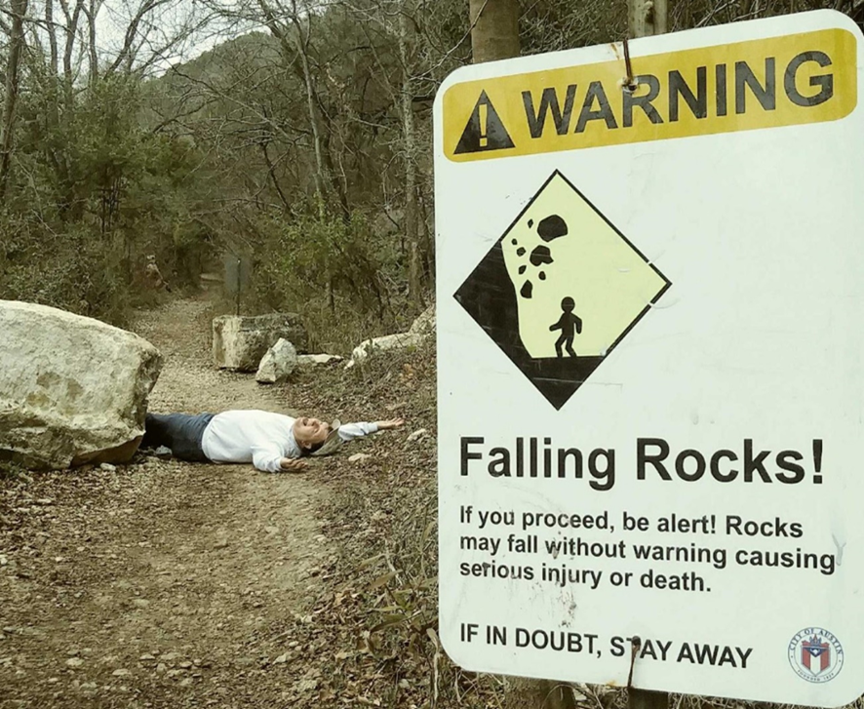
Crew Safety

Slide 7
Tailgate Safety Session
Discuss your project, tools, and personal safety
Review Emergency Action Plan
Review Trailhead Communications Plan
Identify who is carrying the first aid kits
Medical conditions should know about?

Slide 8
Safety Awareness: Go/No Go
All trail workers must constantly analyze whether they should proceed with a task or walk away to ensure their safety.
Crew leaders sometimes exercise such judgement for a group, but it is essential that every trail worker develop these critical thinking skills for when they work on their own.
Such analysis evaluates all the hazards present and balances them against the skills they have.
The most important thing every trail worker needs to know is that it is totally OK and they show the very best judgement when they walk away from danger

Slide 9
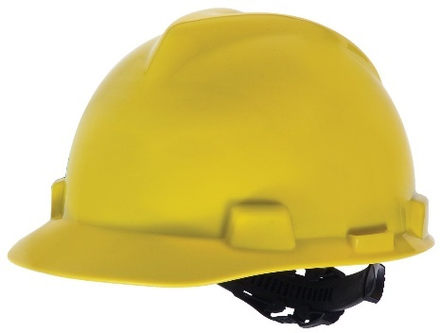
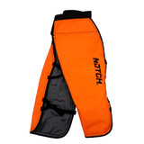
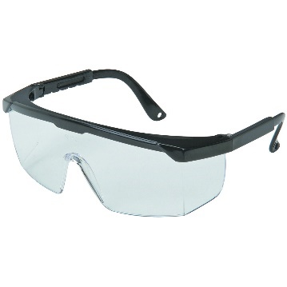
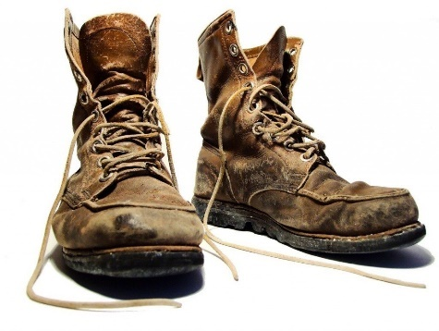
Personal Protective Equipment (PPE)

Slide 10
Tool Tips
Your most important tool is your brain—use it.
Always use proper personal protective equipment
Select the right tool for the job. Carefully inspect each tool. Make sure the handles are sound, smooth, and straight, and that the heads are tight.
Pace yourself. Take rest breaks, drink plenty of water, and keep your mind on your work.
When carrying, loading, or storing a cutting tool, cover the blade with a sheath to protect both the sharp edge and yourself. In vehicles, make sure tools are fastened down.
Carry sharp tools at your downhill side. Grasp the handle at about the balance point with the sharpened blade forward and down. If you fall, throw the tool clear.
At the work site, lay tools on the uphill side of the trail with the business end farthest uphill.

Slide 11
Understanding Trails and Hydrology

Slide 12
Hillside Hydrology
Water from rain, melting snow and seeps poses a major threat to trails.
In a perfect trail world, when water sheet flows down a hillside and encounters a trail with good outslope, it immediately crosses the trail and continues down the hillside without causing any erosion of the trail tread.
In the worst case, hillside sheet flow is interrupted and follows the trail instead. As the water gains volume and speed on steep grades, it erodes a trail into a deep gully filled with rocks and roots left behind after the soil has been carried away.

Slide 13
Sheet Flow
A rolling contour trail—building the trail into the sideslope, maintaining sustainable grades, adding frequent grade reversals, and outsloped tread—let water continue to sheet across the trail where it will do little damage.

Slide 14
Natural Sheet Runoff
In a perfect world, water will cross your trail and continue down the hillside.
Notes:
In a perfect trail world, water from rain, melting snow, and seeps, sheet flows down a hillside and encounters a trail with good outslope and no berm-- it gently crosses the trail and continues down the hillside without causing any erosion of the trail tread.
Water naturally goes down the fall line. The Fall line is the fastest way down the hill. If a trail goes straight up the fall line, there is no way to drain the water off of it.

Slide 15
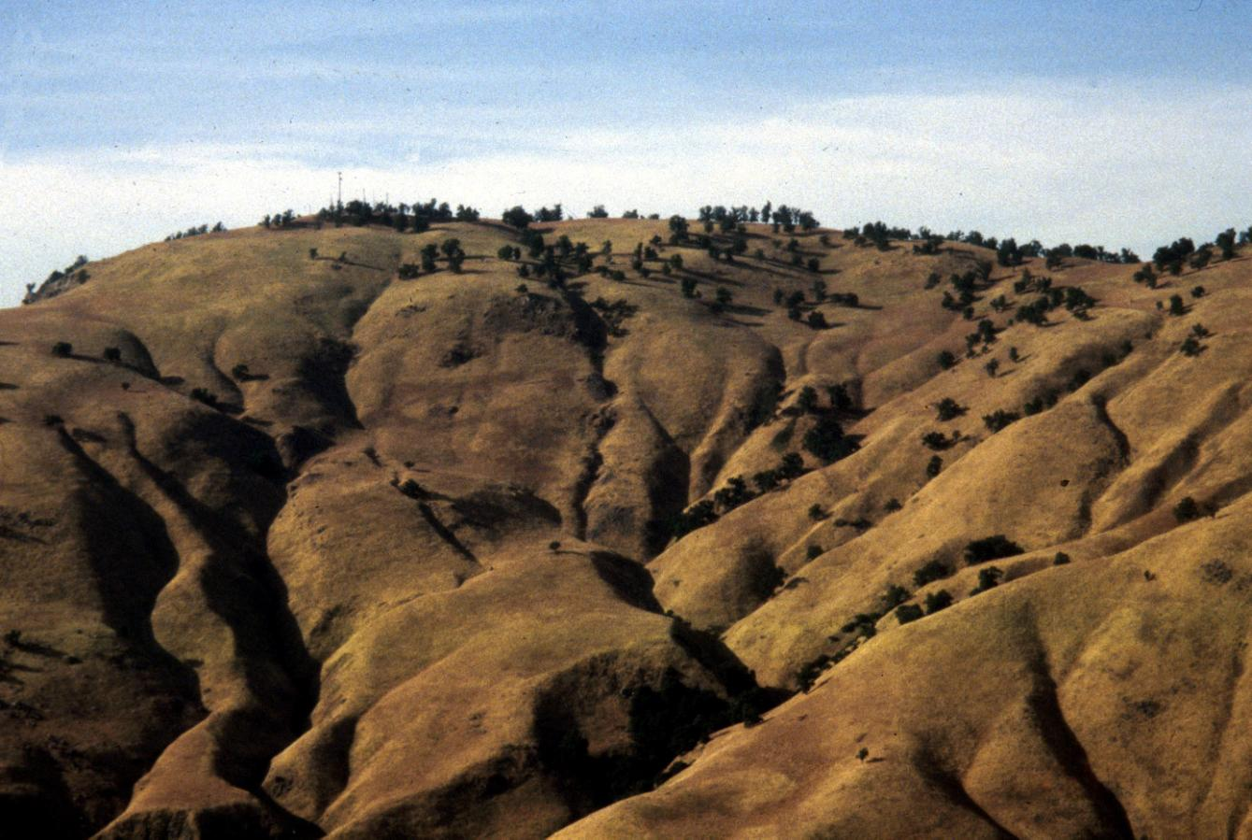
Natural Runoff Patterns
Runoff that begins as uniform sheetflow concentrates into naturally-formed drainages (aka draws, swales) which get bigger and bigger as they descend the hill.
Notes:
In a perfect trail world, water from rain, melting snow, and seeps, sheet flows down a hillside and encounters a trail with good outslope and no berm-- it gently crosses the trail and continues down the hillside without causing any erosion of the trail tread.
Water naturally goes down the fall line. The Fall line is the fastest way down the hill. If a trail goes straight up the fall line, there is no way to drain the water off of it.

Slide 16
Natural Sheet Runoff
Some diversions combine two drainages, dewatering one and destabilizing the other.

Slide 17
Trail Structures

Slide 18
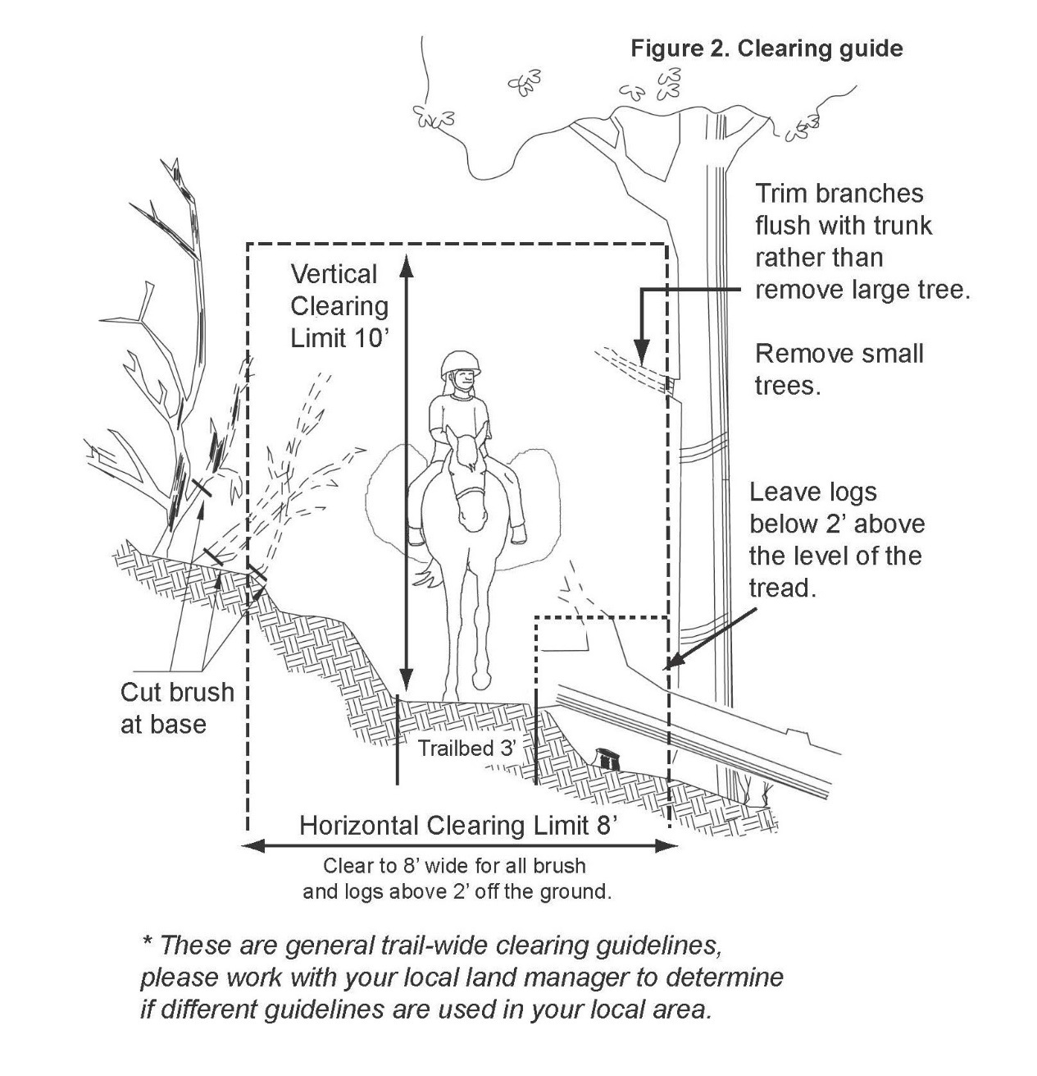
Trail Corridor
The dimensions of the corridor are determined by the needs of the target users and the challenge of the trail.
Trail corridors for traditional packstock are cleared 8 feet wide and 10 feet high. Hiking trails are cleared 6 feet wide and 8 feet high.

Slide 19
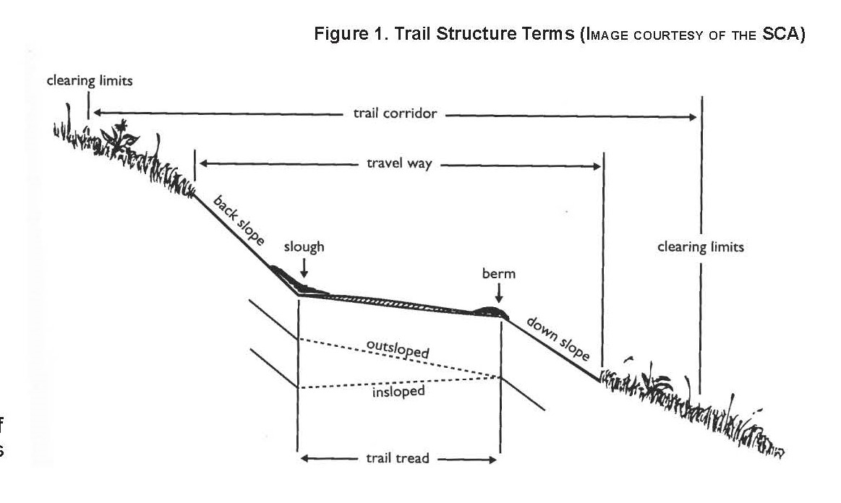
Trail Structure

Slide 20
Full Bench Trail
Trail professionals almost always prefer full-bench construction.
A full bench is constructed by cutting the full width of the tread into the hillside and casting the excavated soil as far from the trail as possible
Full-bench construction requires more excavation and leaves a larger backslope than partial-bench construction, but the trailbed will be more durable and require less maintenance.
You should use full-bench construction whenever possible.

Slide 21
Backslope
The backslope is the excavated, exposed area above the tread surface.
Backslopes are noted as a ratio of vertical rise to horizontal distance, or "rise" to "run.“
The backslope should match the angle of repose of the parent material (the sideslope). You may come across trail specifications calling for 1:1 backslope. This means a 3-foot vertical rise to a 3-foot horizontal run.
Most soils are stable with a 1:1 backslope. Solid rock can have a steeper 2:1 backslope, while less cohesive soils may need a 1:2 backslope.

Slide 22
Switchbacks and Climbing Turns
A switchback in hiking terms is defined as a trail that cuts sharply from one direction to the other while going up a steep hill or mountainside.
Instead of climbing straight up from the foot of a hill to the summit, this specific type of trail allows your hiking effort to be eased through several lesser degree slopes.

Slide 23
Climbing turns are preferred

Slide 24
Grade Reversals

Slide 25
Grade Reversals
The basic idea is to use a reversal in grade to keep water moving across the trail.
A trail with grade reversals and outsloped tread encourages water to continue sheeting across the trail—not down it.
The beauty of grade reversals is that they are the most unobtrusive of all drainage features if they are constructed with smooth grade transitions.
Grade reversals require very little maintenance.

Slide 26
Retaining Wall
Retaining walls are structures of stone or wood designed to stabilize the trail base on steeper side slopes. They are time consuming to construct but may be necessary to prevent soil slide or slump when sidehill trails are crossing the face of a slope that exceeds 40% to 50%.

Slide 27
Knicks
The knick is an effective outsloped drain.
For a knick to be effective, the trail tread must have lower ground next to it so the water has a place to drain.
A knick is a shaved down semicircle about 3 meters (10 feet) long that is outsloped about 15 percent in the center.
Knicks are smooth and subtle and should be unnoticeable to users.

Slide 28
Waterbars
Make sure that waterbars are installed correctly and are in the right location.
Water moving down the trail turns when it contacts the waterbar and, in theory, is directed off the lower edge of the trail.

Slide 29
Rock Waterbar

Slide 30
The problem with waterbars
Dips Are In, Bars Are Out
Waterbars are the most failed structure on trails.
For existing trails with water problems, we encourage the use of rolling grade dips or knicks instead of waterbars. Here's why.
By design, water hits the waterbar and is turned. The water slows down and sediment drops into the drain.
Waterbars commonly fail when sediment fills the drain. Water tops the waterbar and continues down the tread. The waterbar becomes useless.
You can build a good rolling grade dip quicker than you can install a waterbar, and a rolling grade dip works better.

Slide 31
Rolling Drain Dips

Slide 32
Rolling Drain Dip

Slide 33
Check Dam
This is not a waterbar.

Slide 34
Check Dams
Check dams are used on sections of abandoned, trenched tread to stop erosion and hold material in place during site restoration.
Check dams are intended to slow and hold surface water long enough for the water to deposit sediment it is carrying.
Check dams should be used with drainage structures to reduce overall erosion from the abandoned tread.

Slide 35
Drainage Crossings
The simplest drainage crossing structure that will be effective is the best choice.
Complex solutions simply have more ways to fail and generally need more maintenance.
For example, a well-built armored swale is likely to last longer and require less maintenance than a culvert or step-down drain.
Similarly, a bridge is much more likely to fail than stepping stones, which in turn are more likely to fail than a simple ford without stepping stones.

Slide 36
Drainage Crossings: Armored Swales
Armored Swales are a type of grade reversal designed into a trail to shed water by contouring down through a small natural drainage.
The swale should be armored (hardened) with large deeply-set fitted rocks.
Fast water requires inclusion of a downstream rock apron to prevent back cutting.

Slide 37
Trail Design

Slide 38
Trail Specifications
The steepness of the hillside determines how difficult a trail is to build.
The steeper the hillside, the more excavation will be needed to cut in a stable backslope.
Trail grade also has a direct bearing on how much design, construction, and maintenance work will be needed to establish solid tread and keep it solid.
Most high-use trails should be constructed with an average trail grade in the 5- to 10-percent range.
Trails of greater difficulty can be built at grades approaching 15 percent if solid rock is available.
Trails steeper than 20 percent become difficult to maintain in the original location without resorting to steps or hardened surfaces.

Slide 39
Scouting the Route in the Field
Don't trust an eyeball guess for grade; use your clinometer.
Large trees often have natural benches on their uphill side. It's better to locate your trail there than on the downhill side where you'll sever root systems and generally undermine the tree. Look for natural platforms for climbing turns or switchbacks. They save construction costs and better fit the trail to the land.
Cross ravines at an angle rather than going straight up and down the ravine banks. Flag locations for grade reversals. Look for small draws to locate grade reversals. The trail should climb gently for a few feet on each side of the draw. Avoid laying a trail out on flat terrain because water has no place to drain.

Slide 40
5 Essential Elements of Sustainable Trails
The Half Rule: A trail’s grade should not exceed half the grade of the hillside or side-slope that the trail traverses.
The Ten Percent Average Guideline: Generally, an overall (average) trail grade of 10 percent or less is sustainable.
Maximum Sustainable Grade: Although maximum sustainable trail is usually around 15 to 20 percent, it is site-specific and dependent on a number of factors – including: the Half Rule, Soil Type, Tread Make-up, Annual Rain/Snowfall, Grade Reversals, Types of Users, Number of Users, and Difficulty Level.
Grade Reversals: A grade reversal is a spot at which a climbing trail levels out and drops subtly for 10 to 50 feet before rising again – water exits the trail tread at the low point of a grade reversal.
Outslope: As the trail contours across a hillside, the downhill or outer edge of the trail’s tread should be slightly lower than the inside edge – by about five percent. Outslope encourages water to sheet across the trail rather than traveling down the trail’s center.

Slide 41
The Half Rule
The half rule says that the trail grade should be no more than half the side slope grade.
This rule really helps when putting trails on gentle side slopes.
For example, if you're working on a hill with a 6-percent sideslope, your trail grade should be no more than 3 percent.
If the trail is any steeper, it will be a fall-line trail.

Slide 42
Trail Maintenance

Slide 43
Trail Maintenance
Correct truly unsafe situations.
Correct problems that are causing significant trail damage, such as erosion.
Restore the trail to the planned design standard.
Actions can range from simply adding reassurance markers along a trail to a full-blown reroute of poorly designed sections of eroded trail.
Whatever the priority, maintain the trail when the need is first noticed to prevent more severe and costly damage later.

Slide 44
Protect a trail from erosion
To protect a trail from erosion, 3 things need to happen:
Reduce the amount of water running down a trail;
Reduce the speed of the water moving down a trail; and
Reduce the erosive force of users’ feet loosening the soil.

Slide 45
Brushing
If time and budgets are tight, consider brushing only the uphill side of the trail. This approach keeps users off the trail's downhill edge and keeps the trail in place.
Scatter the resulting debris as far as practical.
Toss stems and branches so the cut ends lie away from the trail (they'll sail farther through brush as well).
Don't windrow the debris unless you really and truly commit to burn or otherwise remove it (and do this out of sight of the trail).

Slide 46
Brushing
Before
After

Slide 47
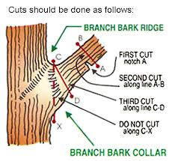
Proper Pruning Cuts
The branch collar contains trunk or parent branch tissue and should not be damaged or removed.
The thickened section of bark just outside the spot where a branch joins the tree is called the “bark collar”.
When cutting branches, always cut just to the outside of this. Make sure it is cut flat and not pointed in any way as this could injure other passing users.
If the trunk collar has grown out on a dead limb to be removed, make the cut just beyond the collar. Do not cut the collar.

Slide 48
Revegetate Abandoned Trails
Restore abandoned trails to their natural state (Revegetation)
Passive Method = Stop erosion and prepare the soil to allow grass and plants to grow back naturally.
Active Method = Transplanting native plants and seed with native grasses.

Slide 49
Questions?
Contact Information
Kevin Deiters, President
Central Texas Trail Tamers
www.trailtamers.org
president@trailtamers.org

